Slide 1
KSB Pumps Company Limited-Pakistan Corporate Briefing Session (CBS-2022)
Dated: 23th February, 2022
KSB Pumps Company Limited

Slide 2


KSB Worldwide Being Global Means Being Closer
KSB Group About Us
KSB is one of the world’s leading manufacturers of pumps and valves, providing a comprehensive range of service offerings.
With its 33 production and assembly sites in 16 countries and a tightly knit global sales and service network, KSB staff are active in more than 100 countries.
KSB production sites
KSB sales and service sites

Slide 3
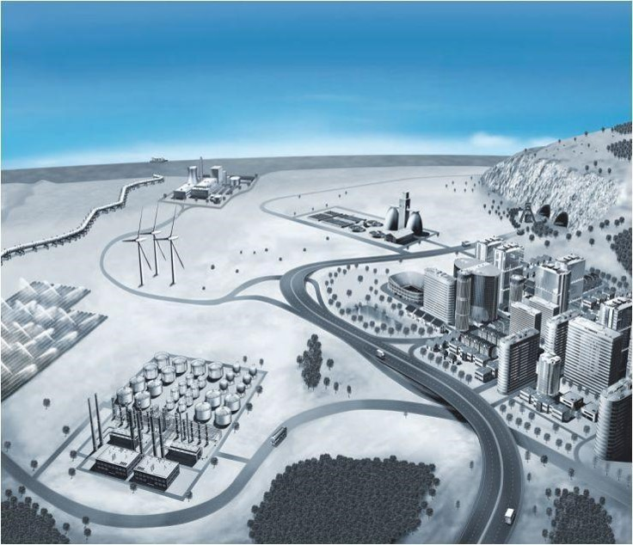
Markets Areas Products for a variety of Applications
Water
General Industry including Auto Parts
Petro-Chemical
Building Services
Energy

Slide 4
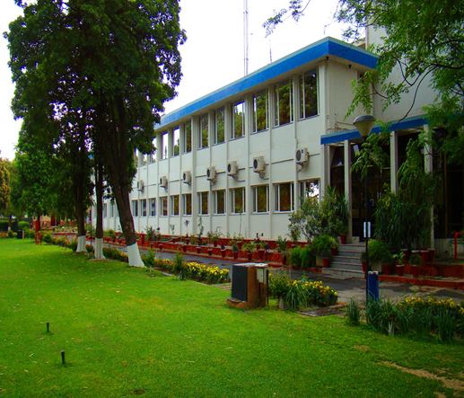
KSB Pakistan Overview
1953: First agency in Asia: Pakistan
Foundation: 1964
Site size - Total area: 89.070 m²
Covered area: 10,000 m²
Product: Pumps & Filtration Plants
Capacity Pumps: 5000 Units/Annum
Foundry: Ferrus/Non-Ferous
20,000 Tons/ Annum
ISO 9001, ISO 14001 & ISO 18001 certified
Environmental Excellence Award

Slide 5
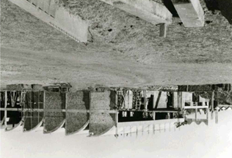
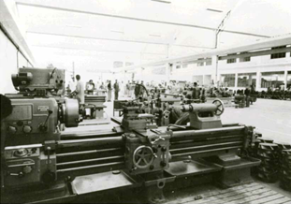
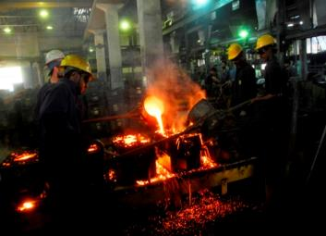
1959 KSB AG established its first subsidiary in Asia
1964 Factory built at Hassanabdal
1979 Became Public Limited Company
1980 Established own foundry – Only Foundry Based Pump Manufacturing
First Global Manufacturing Network Company in the world to achieve Made by KSB Certification
2007 Launched lean manufacturing program new CNC set up for pumps production and initiated product modernization new latest pumps/valves
2009 First subsidiary in Asia-Pacific and Middle East / Africa to complete 50 years of operation
Roll-out of SAP P14.
2018 New High Pressure Cast Iron Automated Foundry And Separate Foundry for Special Materials
KSB Pakistan is country’s leading manufacturers of pumps and valves, providing a comprehensive range of service offerings. It’s the only Foundry based manufacturing set up to support local market needs and huge potential for exports.
KSB Pakistan Our Success at a Glance
Notes:
5

Slide 6
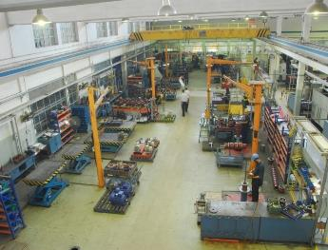
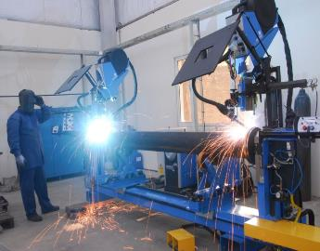
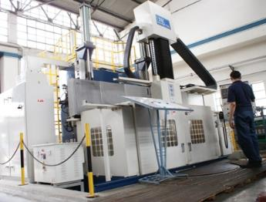
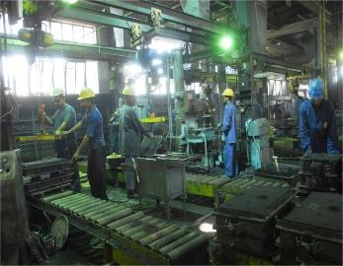
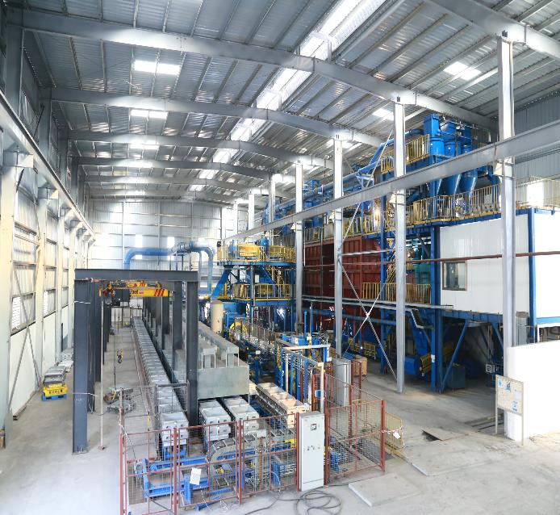
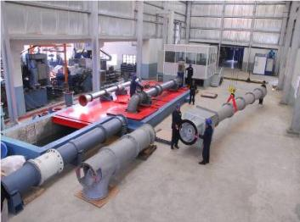
KSB Pakistan Factory Manufacturing at a Glance

Slide 7
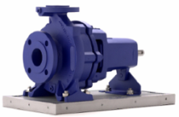

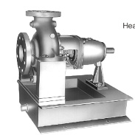
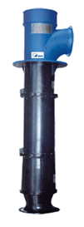
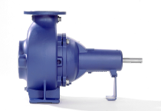

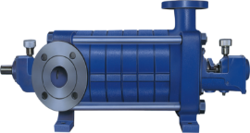
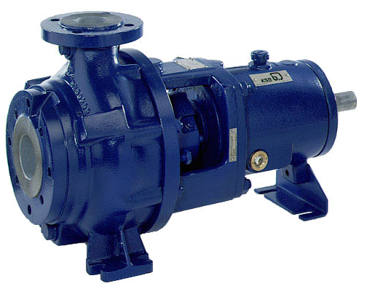
KSB Pakistan Product Portfolio
1
2
3
Type Series Products
Etanrom
RPH
RPK
SNW / PNW
KWP
Sewatec
Omega
WKF/WKL
Etanorm
RPH
RPK
4
5
6
KWP
Sewatec
7
8
SNW / PNW
Omega
WKF/WKL

Slide 8
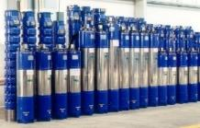



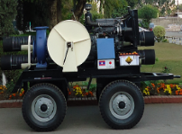
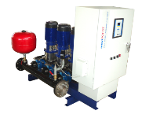
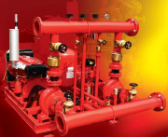
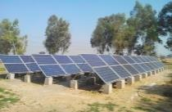
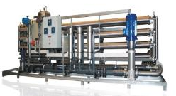
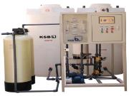
KSB Pakistan
Product Portfolio
9
10
11
12
Submersibles Pumps
KVP
ALTA
B Pump
Portable Dewatering Units
Moviboost System
Fire Fighting Unit System
Solar Pumping Solution
Filtration Plant System (RO & UF)
Submersibles
ALTA
KVP
B Pump
13
14
15
Portable Dewatering Units
Moviboost System
Fire Fighting Unit System
16
17
Solar Pumping System
Filtration Plant System: (RO & UF)

Slide 9
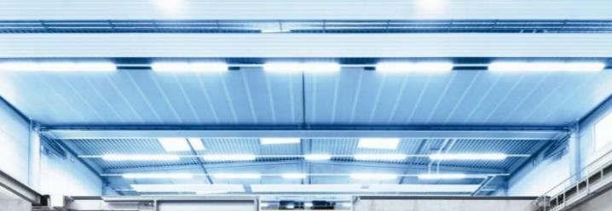
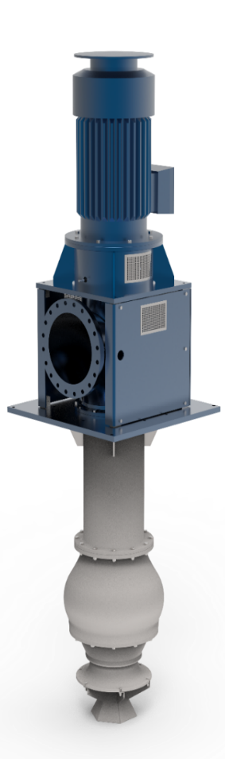
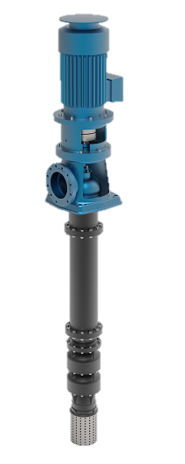
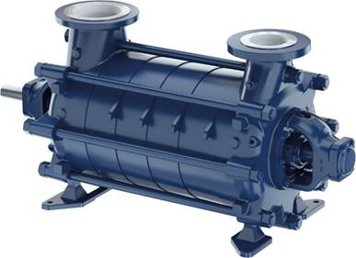
KSB Pakistan
Export Pump & Parts:
B Pumps, SNW/PNW
Own Castings Pumps
Impellers / Propellers
Casings
Diffusers
Discharge Heads
Brackets
Bowls
Exports Pump Parts
South Africa
Germany
Saudi Arabia
USA - GIW

Slide 10
KSB Pakistan - Financials Key Figures
Description | September 2020 | September 2021
Company Order Intake | 2,497 | 3,829
Sales | 2,490 | 3,039
Intercompany Sales (Export) | 567 | 432
Operating Profit (EBIT) | 112 | 93
EBT | 5.7 | 23
EBIT / (Loss) | 4.5% | 3.1%
ROS / (Loss) | 0.2% | 0.8%
Earning / (Loss) per share | (1.50) | (0.96)
Maximum Share Price | 2022 | 2021 | 2020 | 2019 | 2018
 | 186 | 470 | 402 | 183 | 415

Slide 11

KSB Pakistan
Business Outlook
Very optimistic outlook for Pumps/ Valves & Projects businesses.
Higher Growth projection for 1st half compared to 2021.
Government sector activities are anticipated to gear up in the second half of the year 2022 in line with election year 2023 specially in Water Segment.
Efforts in place to secure significant orders from more important projects like Punjab Aab-e-Pak Authority, WASA and Karachi K4.
All values in Mio PKR
KSB Pumps Company Limited
Notes:
11

Slide 12
KSB Pakistan
Business Outlook
Growth expected in the sugar and steel sector as expansions are planned in these areas.
KSB Pakistan products portfolio and infrastructure are geared to provide the best services to our clientele, considering our specialization in this field.
Export business also has strong business prospects for our region of MEA-R specially markets of KSA, SA and Turkey.
Expansion in KSB Pakistan's market share with sustainable growth in the future will remain the key focal point while relying on effective corporate communication for the key growth initiatives.
All values in Mio PKR
KSB Pumps Company Limited
Notes:
12

Slide 13
Thank You
KSB Pumps Company Limited

